Slide 1
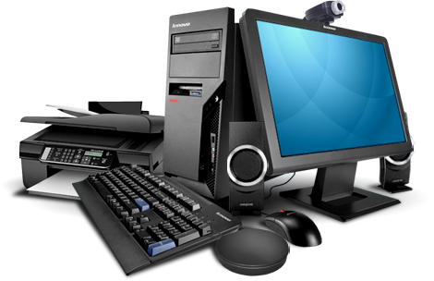


Computer
Hardware
Class V
lab 5

Slide 2

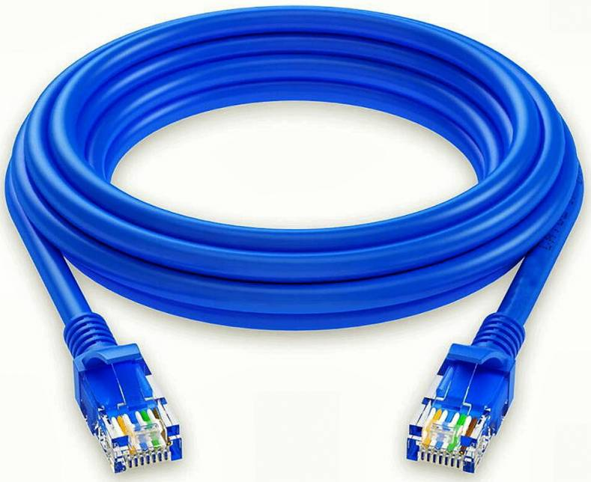
Networking Cables
networking hardware used to connect one network device to other network

Slide 3
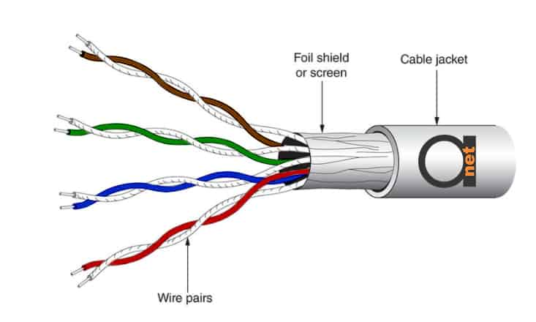
Twisted Pair Cables
two independently insulated wires twisted around one another

Slide 4
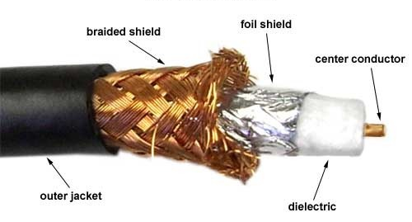
Coaxial Cables
Coaxial cable is a type of copper cable specially built with a metal shield and other components engineered to block signal interference

Slide 5
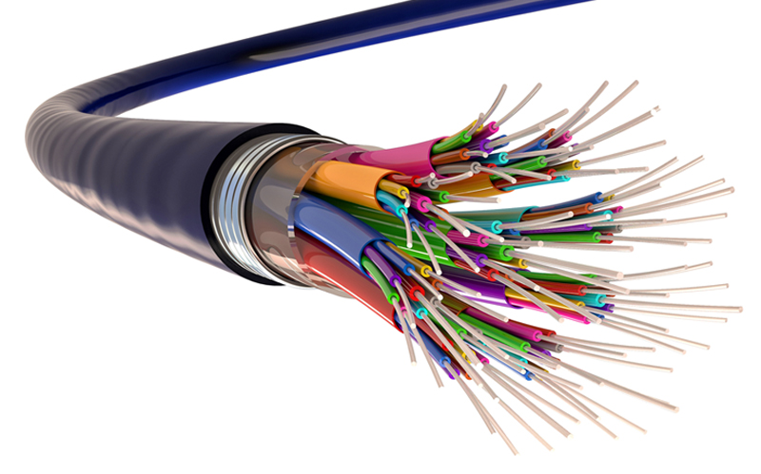
Fiber Optic Cables
one or more thin flexible fibres with a glass core

Slide 6
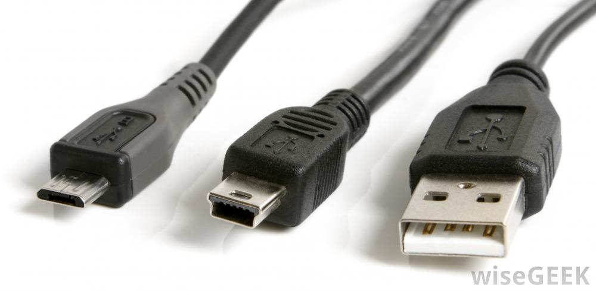
USB Cables
most popular cable types available, used mostly to connect computers to peripheral devices such as cameras, camcorders, printers, scanners, and more.

Slide 7


